Slide 1


INX Future Inc
EMPLOYEE PERFORMANCE PROJECT
FROM DATA TO DECISIONS
PRESENTED BY: Ivy Wangechi Kariuki

Slide 2

PROBLEM STATEMENT
INX Future Inc., a leading data analytics and automation company, is known for its employee-friendly human resource policies, which are widely regarded as industry best practices. In the recent years there has been facing a decline in employee performance, leading to increased service delivery escalations and an 8% drop in client satisfaction levels. The management is now struggling to address performance issues without negatively impacting overall employee morale or the company’s reputation as a top employer.
To tackle this challenge, the CEO has initiated data science project, which analyses the current employee data and find the core underlying causes of this performance issues. This project aims to provide key insights, including department-wise performance analysis, the top three factors influencing employee performance, a predictive model to assess employee performance for hiring purposes, and data-driven recommendations to enhance overall employee performance.

Slide 3
DATASET OVERVIEW
About The Dataset
Sample Size: 1200 Individuals
Data Shape: The Dataset contains 28 columns and 1200 rows.
Class Imbalance: There is a class imbalance in performance ratings, with over 800 employees rated 3, followed by around 200 employees rated 2, and fewer than 200 employees rated 4.
Data Type:
Categorical Columns(9): EmpNumber, Gender, EducationBackground, MaritalStatus, EmpDepartment, EmpJobRole, BusinessTravelFrequency, OverTime, Attrition.
Numerical Columns(19): Age, DistanceFromHome, EmpEducationLevel, EmpHourlyRate, EmpJobInvolvement, EmpJobLevel , EmpJobSatisfaction, NumCompaniesWorked, EmpLastSalaryHikePercent, EmpRelationshipSatisfaction, TotalWorkExperienceInYears, TrainingTimesLastYear, EmpWorkLifeBalance, ExperienceYearsAtThisCompany, ExperienceYearsInCurrentRole, YearsSinceLastPromotion, YearsWithCurrManager, PerformanceRating

Slide 4
EXPLORATORY DATA ANALYSIS
Data Cleaning and Preprocessing.
Cleaning and Preparing the Data
Steps Taken:
Checked for missing Values: There were no missing values.
Encoded the following categorical variables using Mapping (Gender, Education Background, Marital Status, EmpDepartment, EmpJobRole, BusinessTravelFrequency, OverTime, Attrition.).
Duplicates: The dataset has are no duplicates.
Removing outliers in this case can distort the data analysis since the dataset is small. We might also lose valuable information and cause bias in the analysis of the data. Hence, I would not recommend it.

Slide 5
Descriptive Statistics Of The Dataset
Feature | Min | Mean | Max | Std Dev
Age | 18 | 36.92 | 60 | 9.08
Distance from Home | 1 | 9.17 | 29 | 8.18
Employee Education Level | 1 | 2.89 | 5 | 1.04
Employee Environment Satisfaction | 1 | 2.72 | 4 | 1.09
Employee Hourly Rate | 30 | 65.98 | 100 | 20.21
Job Involvement | 1 | 2.73 | 4 | 0.71
Job Level | 1 | 2.06 | 4 | 1.11
Job Satisfaction | 1 | 2.73 | 4 | 1.10
Number of Companies Worked | 0 | 2.67 | 9 | 2.47
Last Salary Hike (%) | 11 | 15.22 | 25 | 3.63
Employee Relationship Satisfaction | 1 | 2.73 | 4 | 1.08
Work-Life Balance | 1 | 2.74 | 4 | 0.70
Total Work Experience (Years) | 0 | 11.33 | 40 | 7.80
Training Times Last Year | 0 | 2.79 | 6 | 1.26
Years at Company | 0 | 7.08 | 40 | 6.24
Years in Current Role | 0 | 4.29 | 18 | 3.61
Years Since Last Promotion | 0 | 2.19 | 15 | 3.22
Years with Current Manager | 0 | 4.10 | 17 | 3.54
Performance Rating | 2 | 2.95 | 4 | 0.52

Slide 6
Summary of the Descriptive Statistics of the Data-Set
Employee age: Minimum age is 18 while maximum age is 60 and most of the individuals are 36 years.
Distance from home: Varies from 1 km to 29 km. Most of the employees live within a 9km distance.
EmpEducationLevel: Most Individuals have an education level of around 3.
Employee Environment Satisfaction: Rated between 1 to 4. Average score is 2.7 suggesting moderate satisfaction.
Employee Hourly Rate: Ranges between 30 and 100. The average hourly rate is 66.
EmpJobInvolvement: Ranges between 1 and 4.Majority of the employees have a moderate involvement of 2 to 3.
Employee Job Level: Ranges between 1 to 5. Majority are in the job level of 1-3. Only a few have the highest job level of 4.
Employee Job Satisfaction: Ranges between 1 to 4. Majority have a moderate to high level of job satisfaction of 2-4.A small number of employees report low job satisfaction(1), which indicates a need for further investigation.
Number of Companies Worked: Minimum companies are 0 while maximum are 9. Majority of the employees have worked at 2 companies before while other have worked for 4 or more companies.
Employee Last Salary Hike Percent: Varies from 11 to 25. Most of the employees have received an average salary hike of 15%.
Employee Relationship Satisfaction: Ranges between 1 to 4. Most employees have moderate to high relationship satisfaction of 2 to 4.A small number of employees report low relationship satisfaction(1), which indicates a need for further investigation.
Total Work Experience In Years: Minimum years are 6 while maximum years are 40. Most employees have 11 years of work experience.
Training Times Last Year: Minimum sessions are 0 while maximum are 6. Majority have attended 2-3 training sessions.
Employee Work Life Balance: Ranges between 1 and 4.Majority have a moderate work life balance of 2-3.Some employees report poor work-life balance (1), which indicate need for further analysis.
Experience Years At This Company: Minimum years are 6 while maximum years are 40.Majority of employees have worked in the company for 3 to 10 years.
Experience Years In Current Role: Minimum years are 0 while maximum years are 18. Most employees have been in their current role for 2 to 7 years.
Years Since Last Promotion: Ranges between 0 and 15 years. Most employees were last promoted 0 to 3 years ago, suggesting an active promotion cycle. A small number of employees haven’t been promoted for a long period(15 years).
Years With Current Manager: Ranges between 0 and 17 years. Most employees have been with their manager for 2 to 7 years, suggesting a moderate level of managerial stability.
Performance Rating: Ranges between 2 and 4. Majority of the employees have a moderate performance rating of 3.

Slide 7
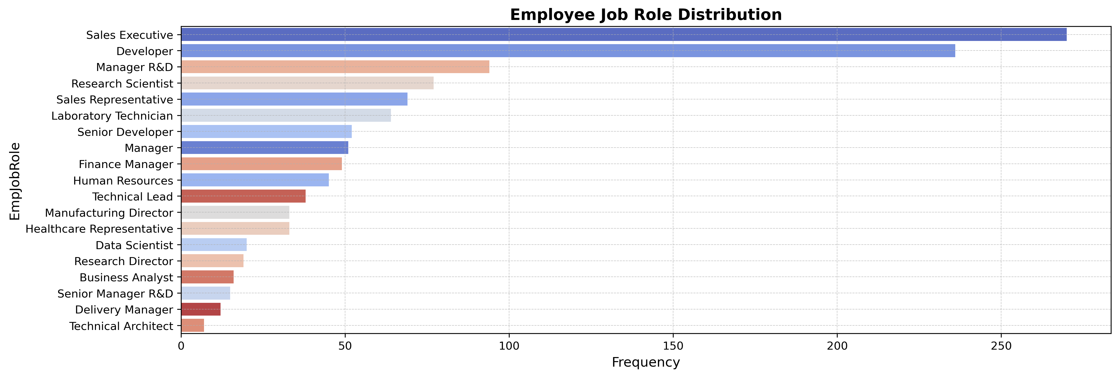
VISUALIZATIONS
a. Univariate Visualizations
Sales Executives have the highest number of employees, with over 250, followed by Developers, who have more than 200. Most other job roles have fewer than 100 employees. Some roles, like Manager R&D, Research Scientist, Sales Representative, Laboratory Technician, Senior Developer, and Manager, have between 50 and 100 employees. The rest, including Finance Manager, Human Resources, Technical Lead, Manufacturing Director, Healthcare Representative, Data Scientist, Research Director, Business Analyst, Senior Manager R&D, Delivery Manager, and Technical Architect, have fewer than 50 employees.

Slide 8
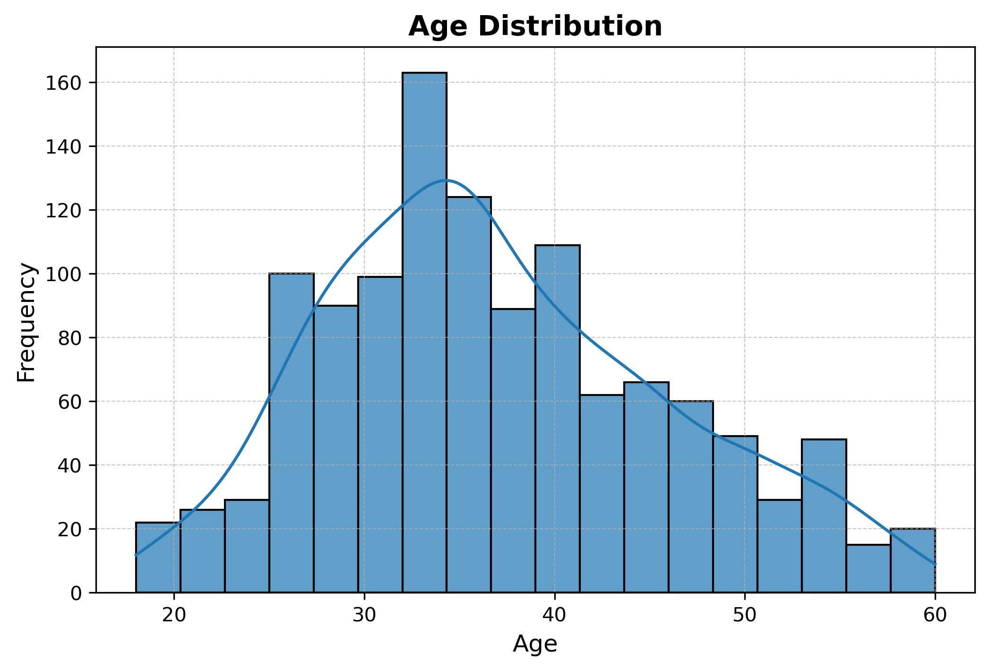
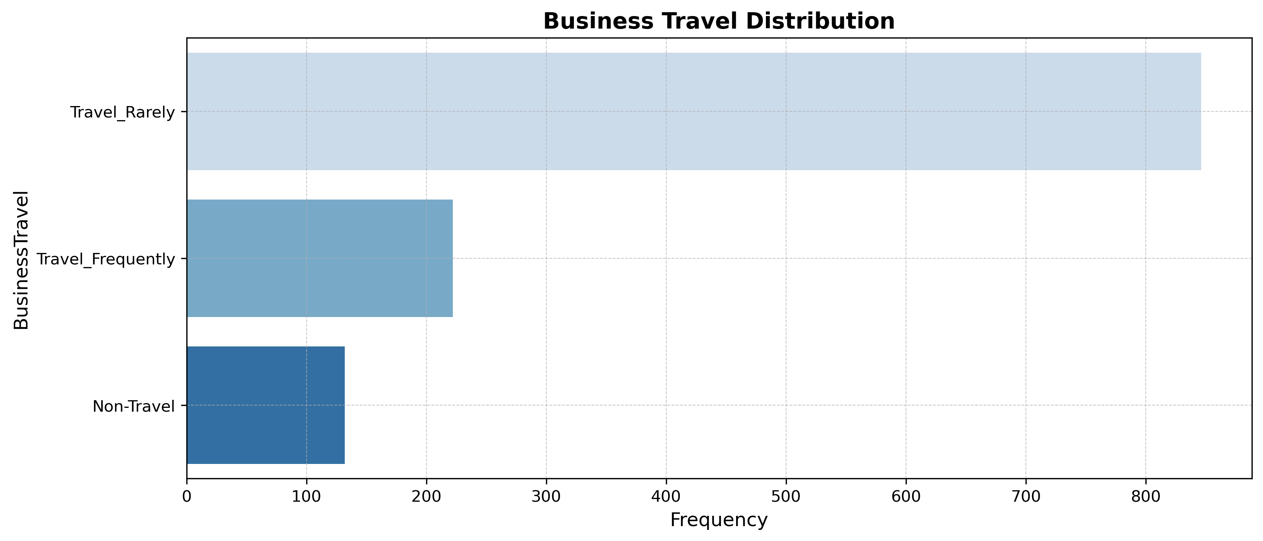
Univariate Visualizations
The minimum employee age is 18, while the maximum is 60. The majority of employees are 36 years old, and the age distribution is right-skewed, indicating more younger employees than older ones.
The majority of employees, over 800, rarely travel for business. Around 200 travel frequently, while just over 100 do not travel at all.

Slide 9
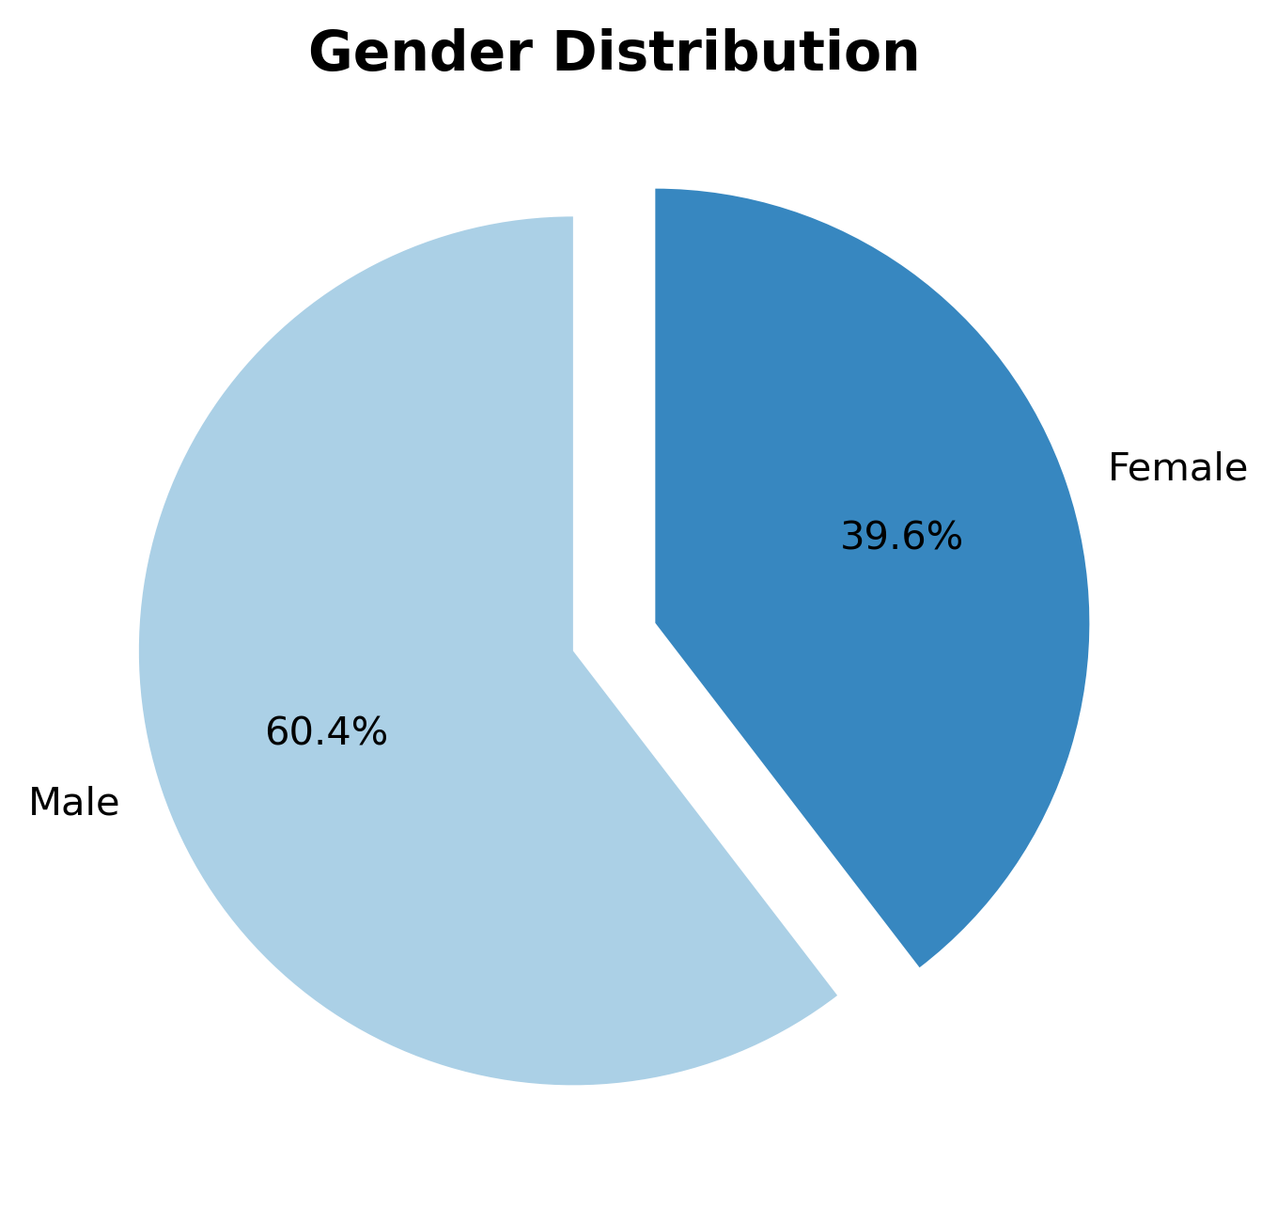
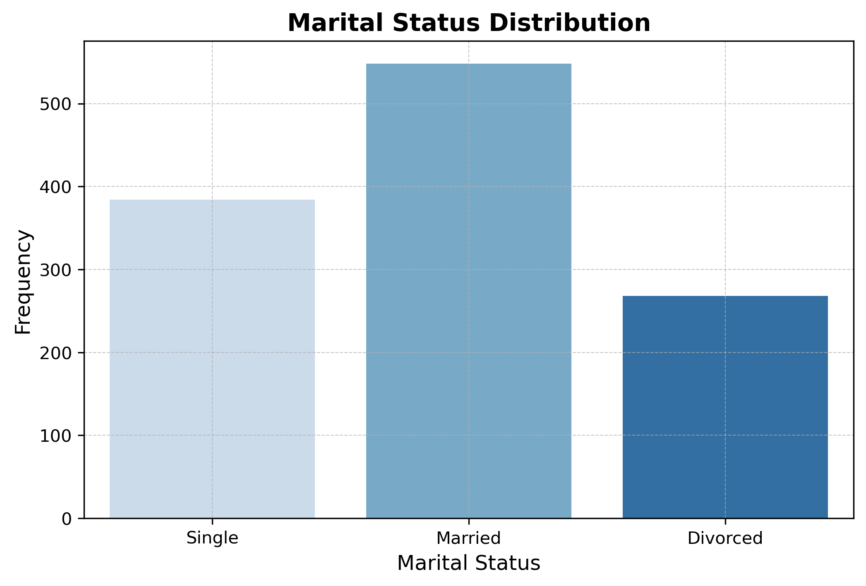
Univariate Visualizations
The majority of employees are male(60.4%), with the remaining portion being female(39.6%).
Over 500 employees are married, followed by approximately 400 single employees. The number of divorced employees is fewer than 300.

Slide 10
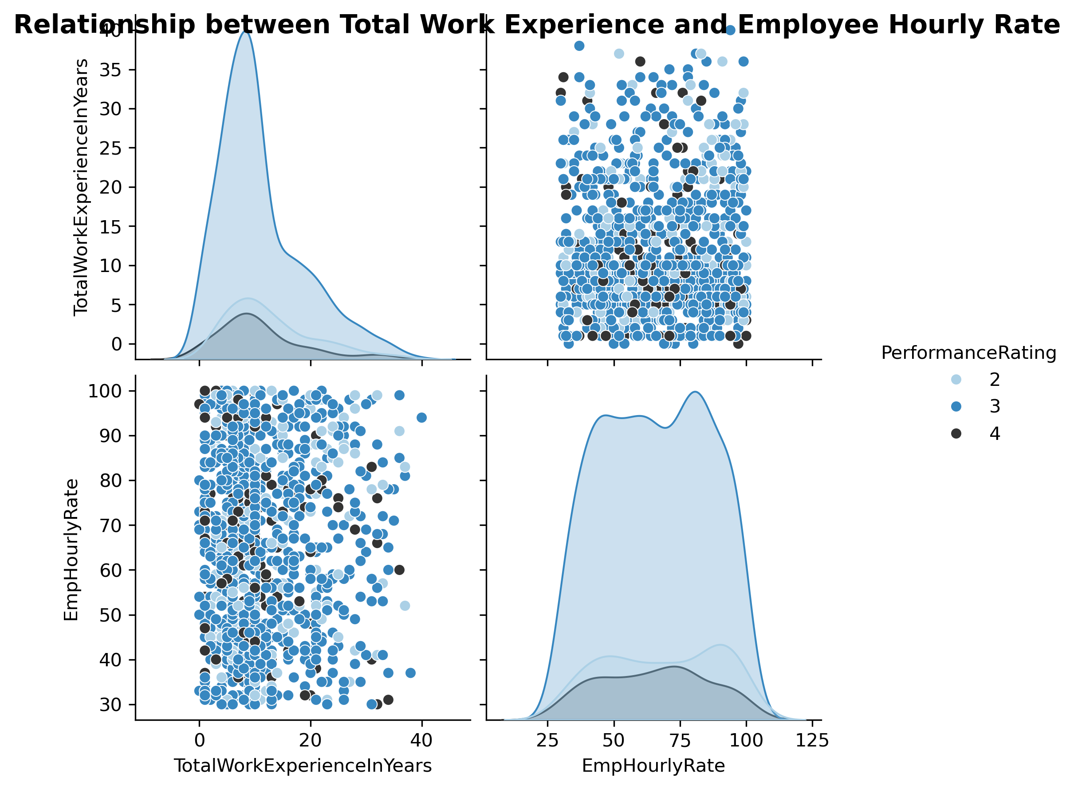
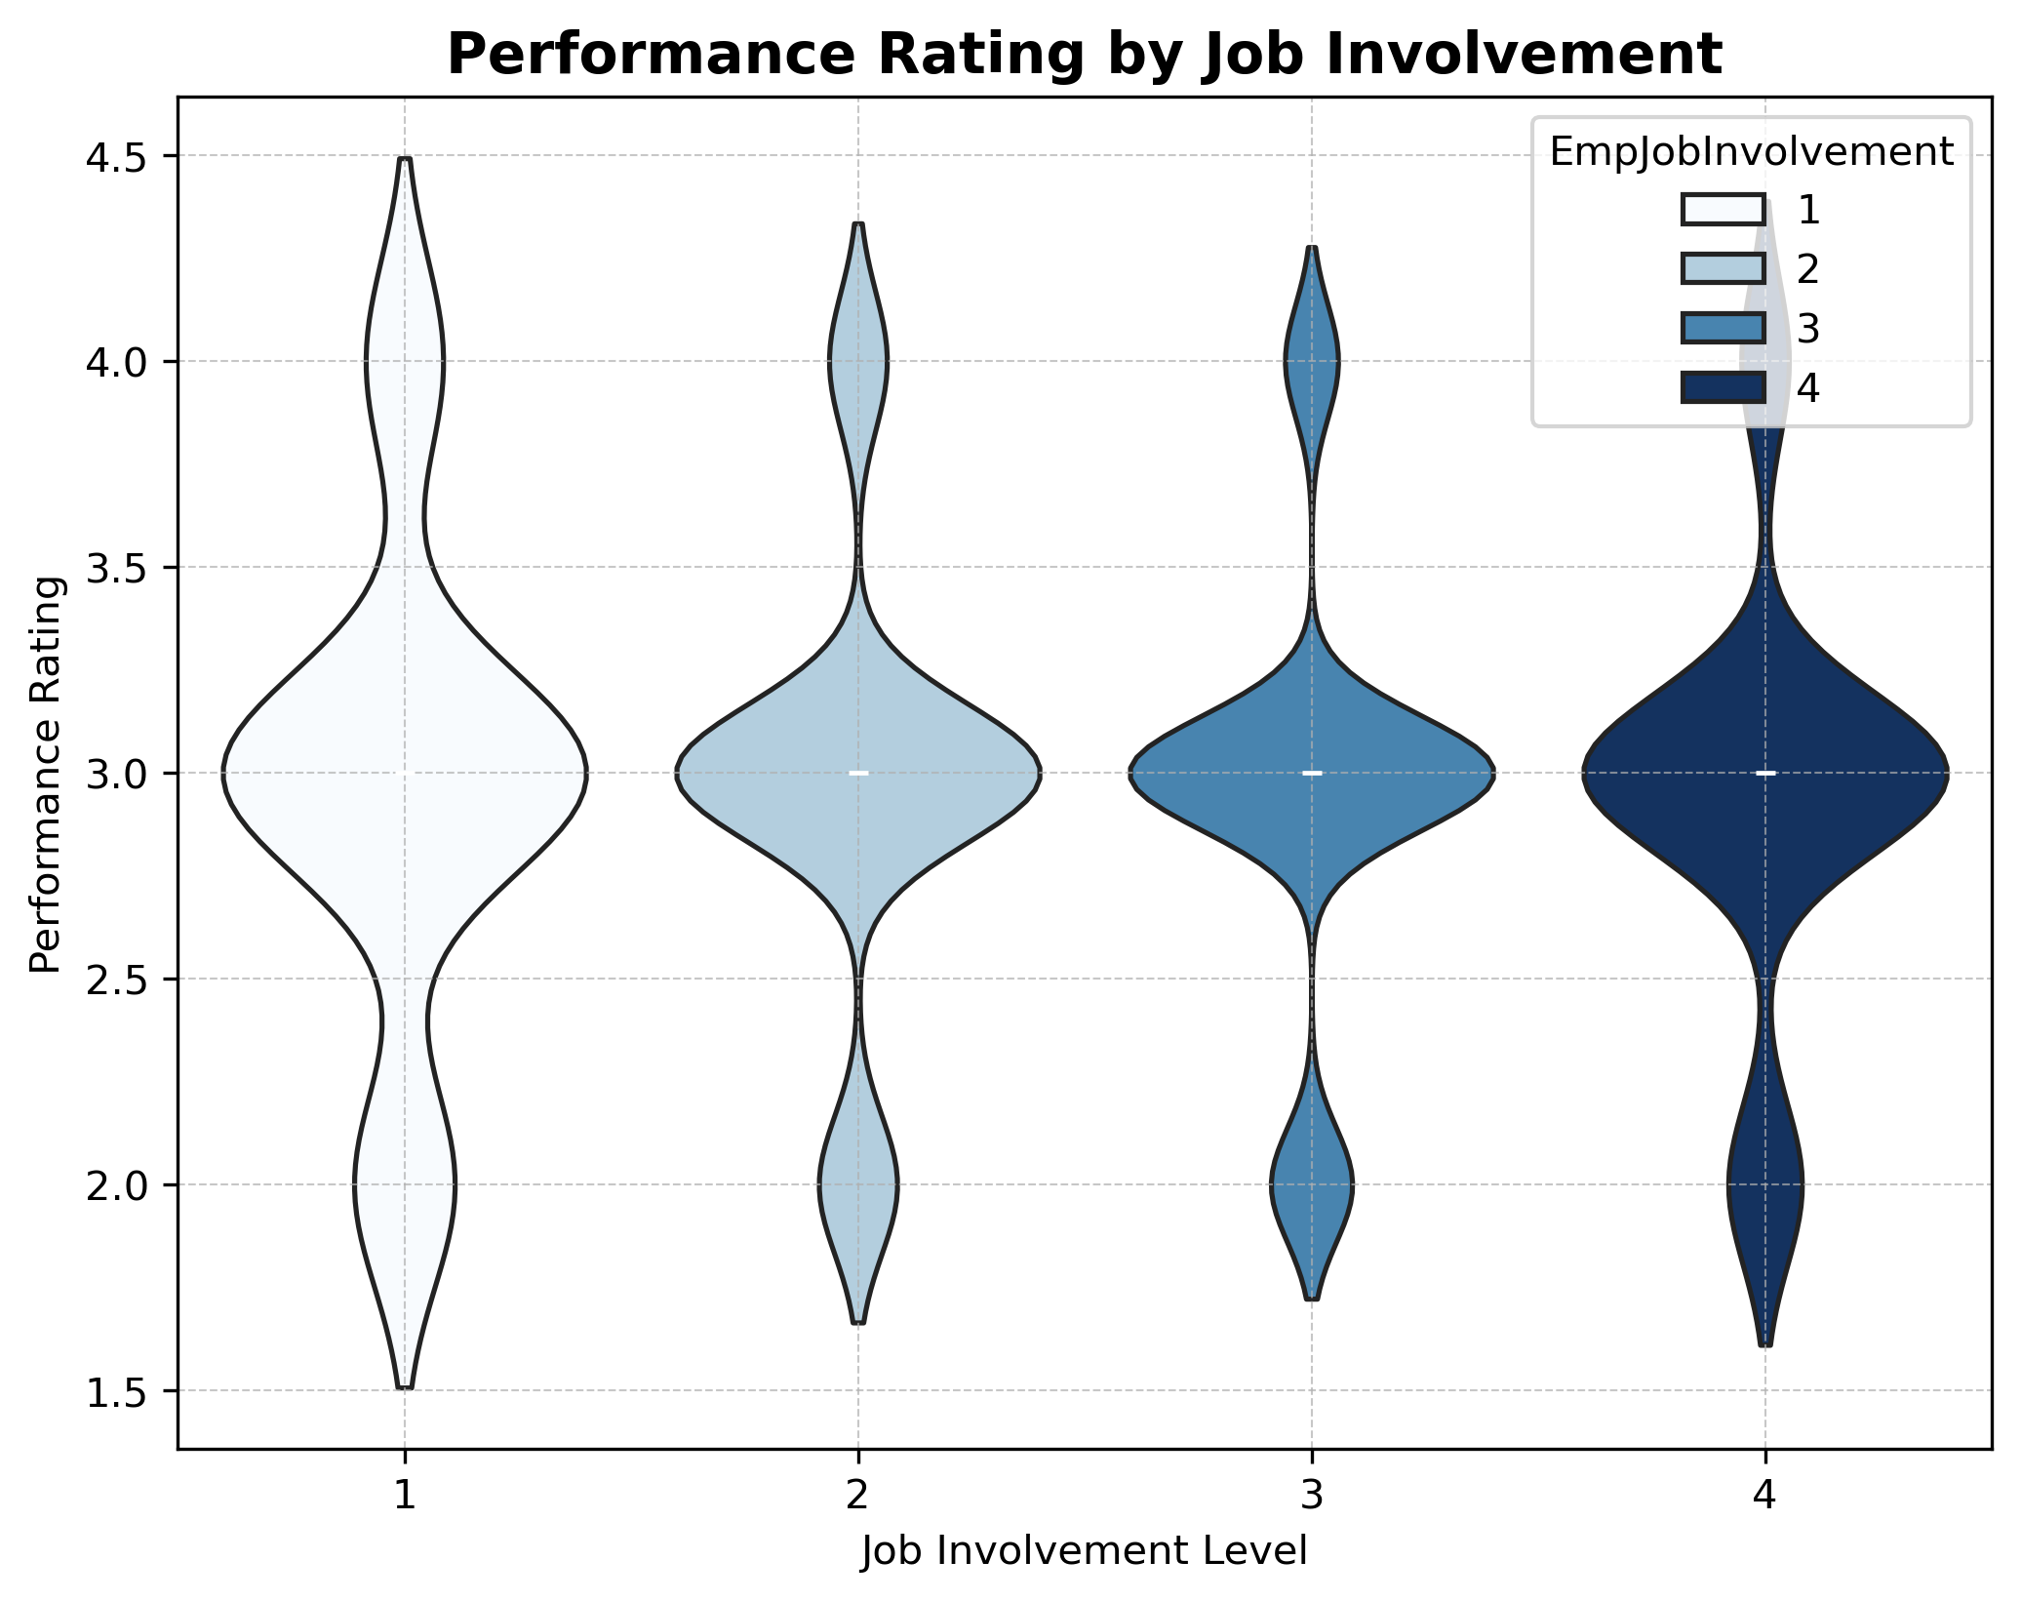
b. Multivariate Visualizations
Most employees have a work experience 0-10 year and have an employee hourly rate of between 25 - 100%. Performance ratings are evenly distributed across total work experience and salary meaning it is not a strong predictor of salary
Across all job involvement levels, the average performance rating is 3. Job involvement level 1 has more employees with a poor performance level of 2 compared to the other levels while others have an outstanding performance rating of 4.This shows that some employees with low involvement perform well, but others receive the lowest ratings. Employees with higher involvement (3 and 4) are more likely to stay around the expected rating of 3 or above showing consistency in this groups.

Slide 11
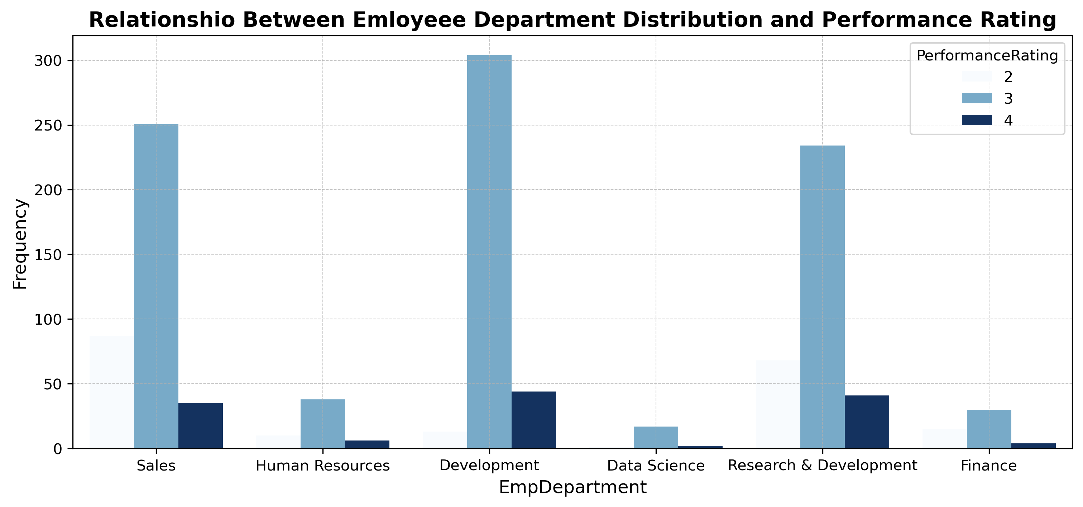
Multivariate Visualizations
Department Wise Performances
The bar chart highlights department-wise performance variations, with most employees receiving a rating of 3 across all departments. Departments with a higher proportion of rating 2 than 4 may indicate performance challenges, while those with more rating 4 than 2 suggest stronger performance.
Development has the highest number of employees (around 300) with a satisfactory rating (3), along with the highest count of excellent-rated employees (4) at nearly 50, while poorly rated employees (2) are fewer than 25. Sales follows, with approximately 250 employees rated 3, a significant number (around 100) rated 2, and fewer achieving rating 4. Research & Development and Finance show a similar trend to Sales. In contrast, Human Resources has a relatively balanced distribution between poorly and excellently rated employees. Notably, Data Science, despite having the fewest employees, has more employees rated 4 than those rated 2. *
These insights can help organizations implement targeted training, workload adjustments, and managerial improvements to enhance overall productivity.

Slide 12
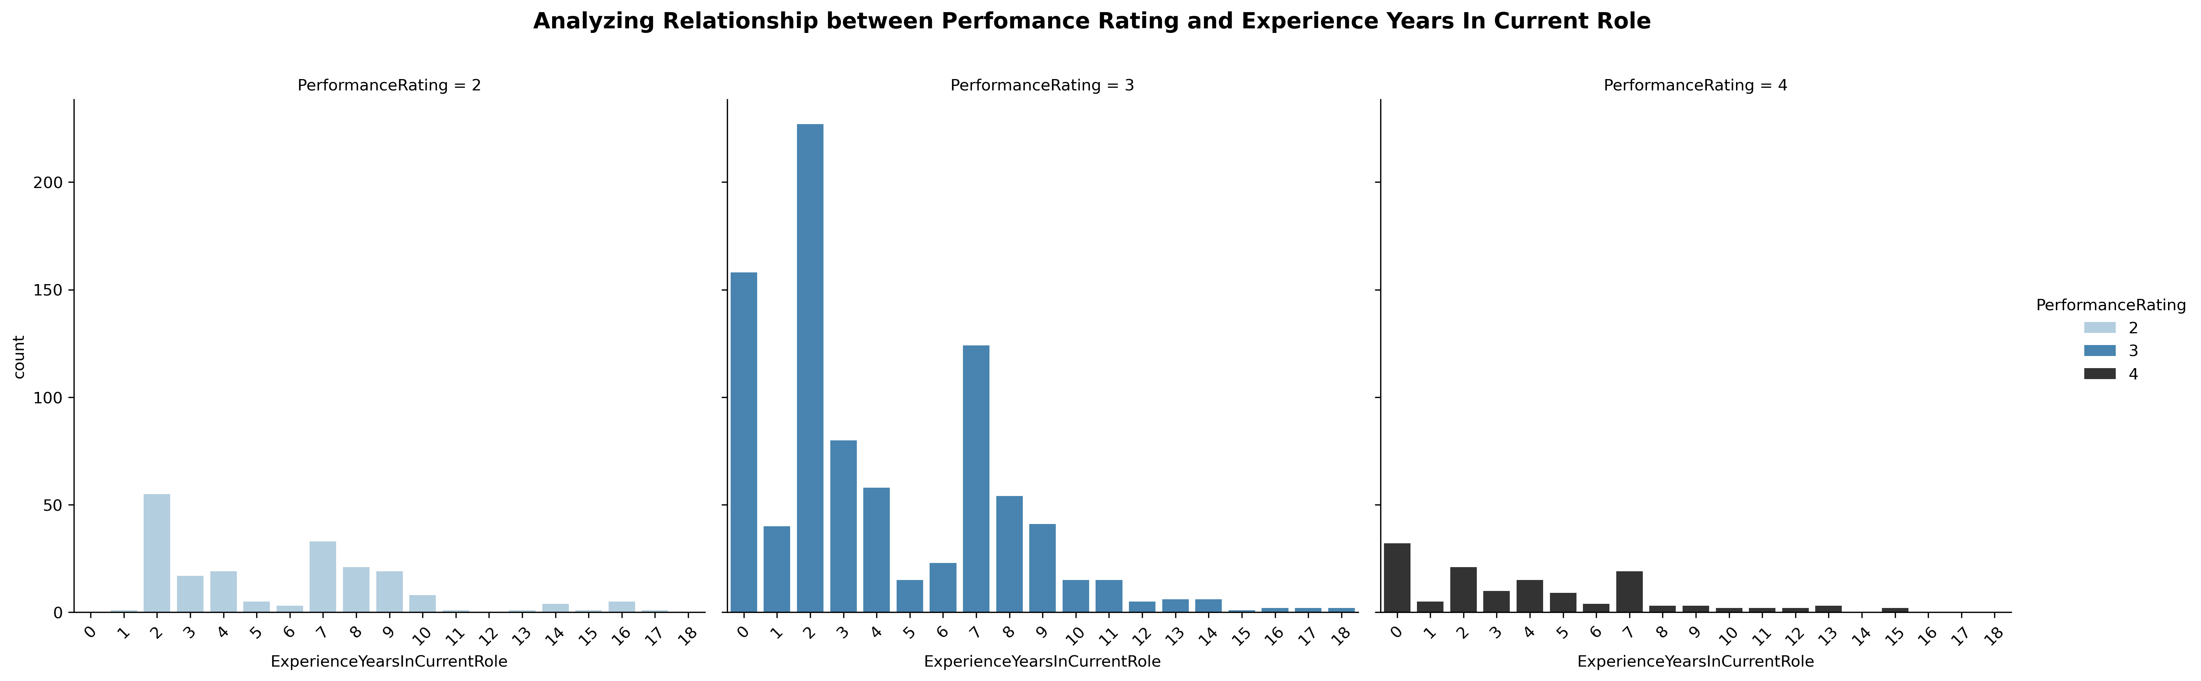
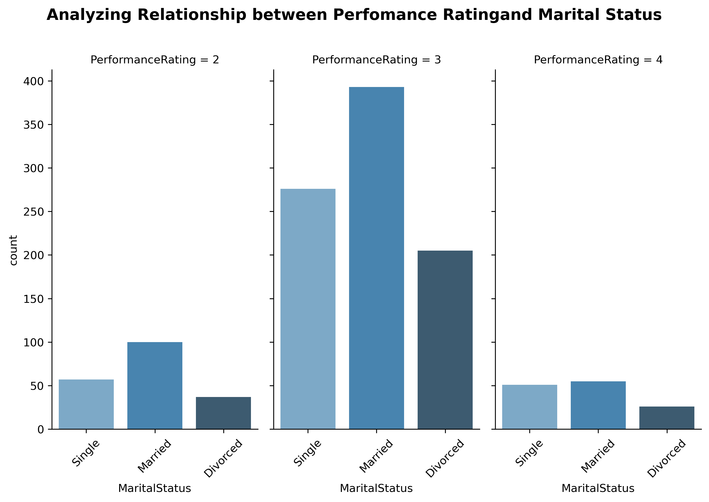
Multivariate Visualizations
Employees with a few years of experience in their current role tend to have the highest performance ratings, indicating that moderate experience is a strong driver of success. On the other hand, those who are new to their roles often struggle, possibly due to a learning curve or lack of familiarity with responsibilities. Interestingly, employees who have spent many years in the same position do not always exhibit top performance, which could point to stagnation or declining motivation over time.
Employees with a performance rating of 2 are primarily married individuals, totaling around 100, followed by single employees, who number close to 50, and then divorced individuals. For a performance rating of 3, married employees make up the largest group at approximately 350, followed by single employees, who are slightly above 200, and divorced individuals, who are slightly close to 200. For a performance rating of 4, married employees form the majority, with close to 50 individuals, followed by single employees, who are fewer than that, and then divorced individuals.

Slide 13
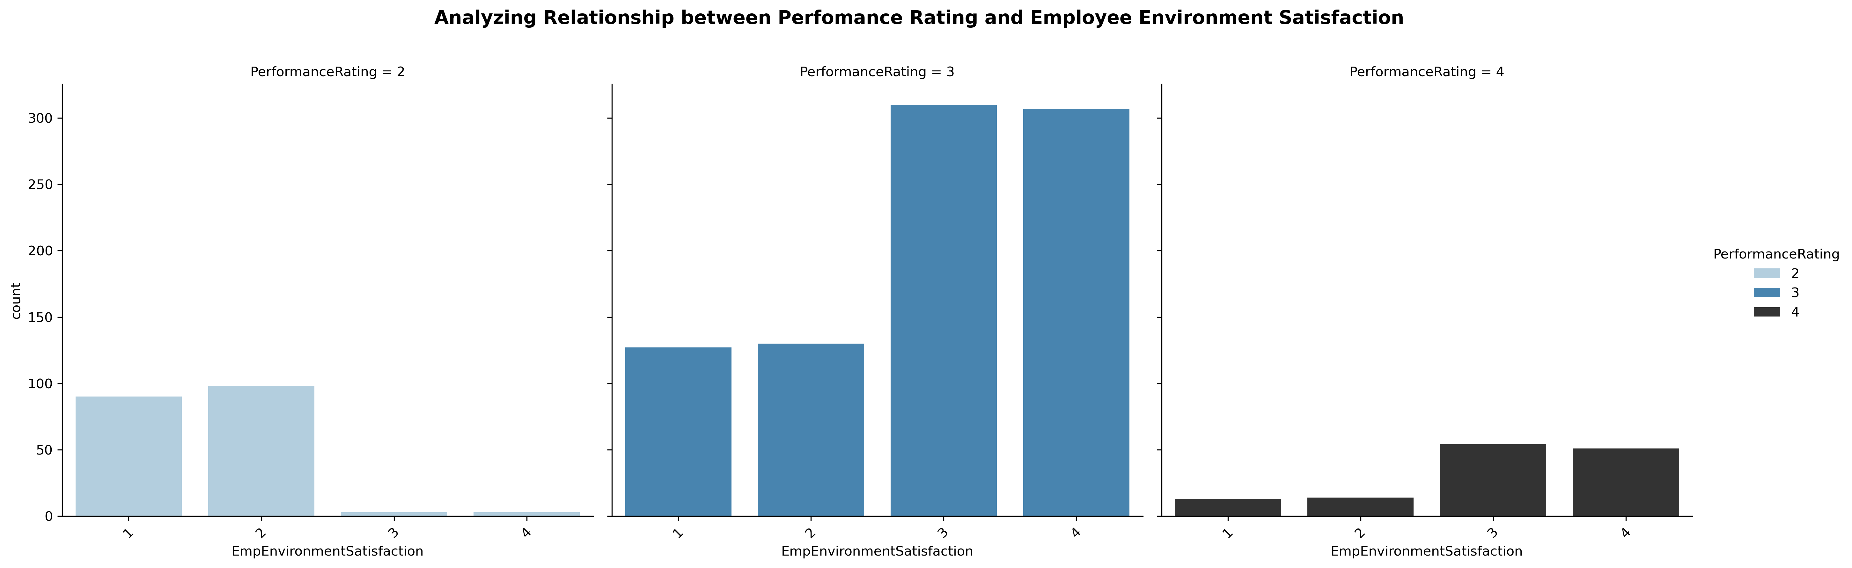
Multivariate Visualizations
Employees with higher environment satisfaction tend to have better performance ratings. Those who rate their work environment as "Excellent" dominate the high-performance category, while those with "Poor" satisfaction are more likely to underperform. This suggests that a positive workplace environment plays a crucial role in employee productivity and engagement. To enhance performance across the organization, companies should focus on improving workplace conditions, fostering a supportive culture, and addressing any dissatisfaction among employees. Creating a more engaging and comfortable work setting could lead to noticeable improvements in overall performance.

Slide 14
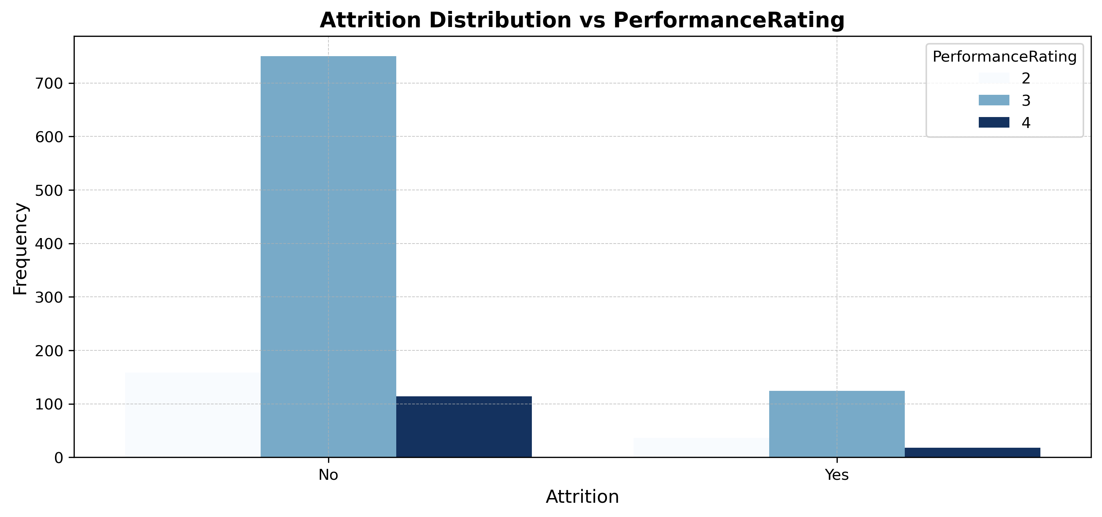
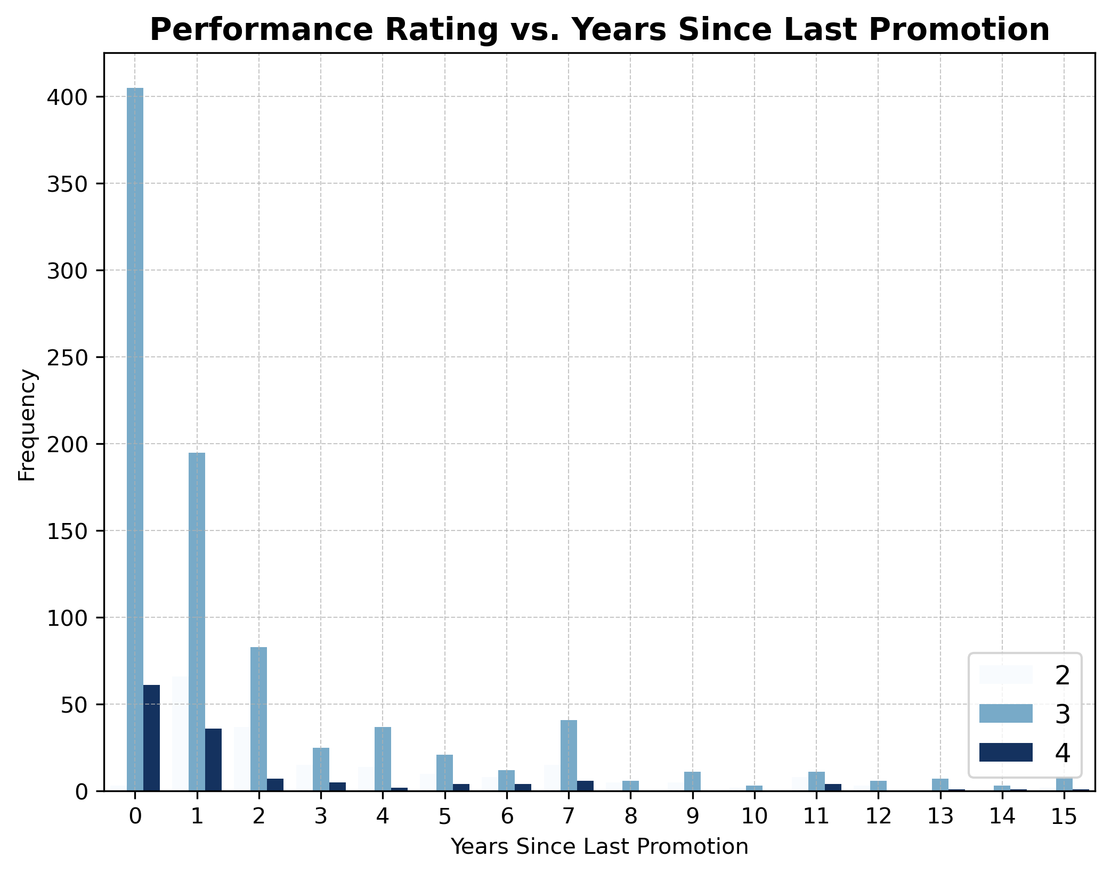
Multivariate Visualizations
About 600 employees who do not work overtime had a satisfactory performance rating of 3, over 100 employees had a poor performance rating(2) while around 100 had an outstanding rating of 4. Among those who work overtime, about 300 had a satisfactory rating(3), and fewer than 50 had an outstanding rating(4) and a poor performance rating(2).
In the first year (0 years since the last promotion), most employees (over 400) were promoted and received a satisfactory performance rating of 3, while more than 50 achieved an outstanding rating of 4—with only a very small number showing poor performance compared to other years. Overall, performance rating 3 dominates across all time frames. Although performance rating 4 is the least common group, it still appears consistently in periods beyond the first year until 8 years, showing a decline in outstanding performance ratings if employees go prolonged periods without a promotion. Additionally, a few employees haven't received a promotion in 10 to 15 years.

Slide 15
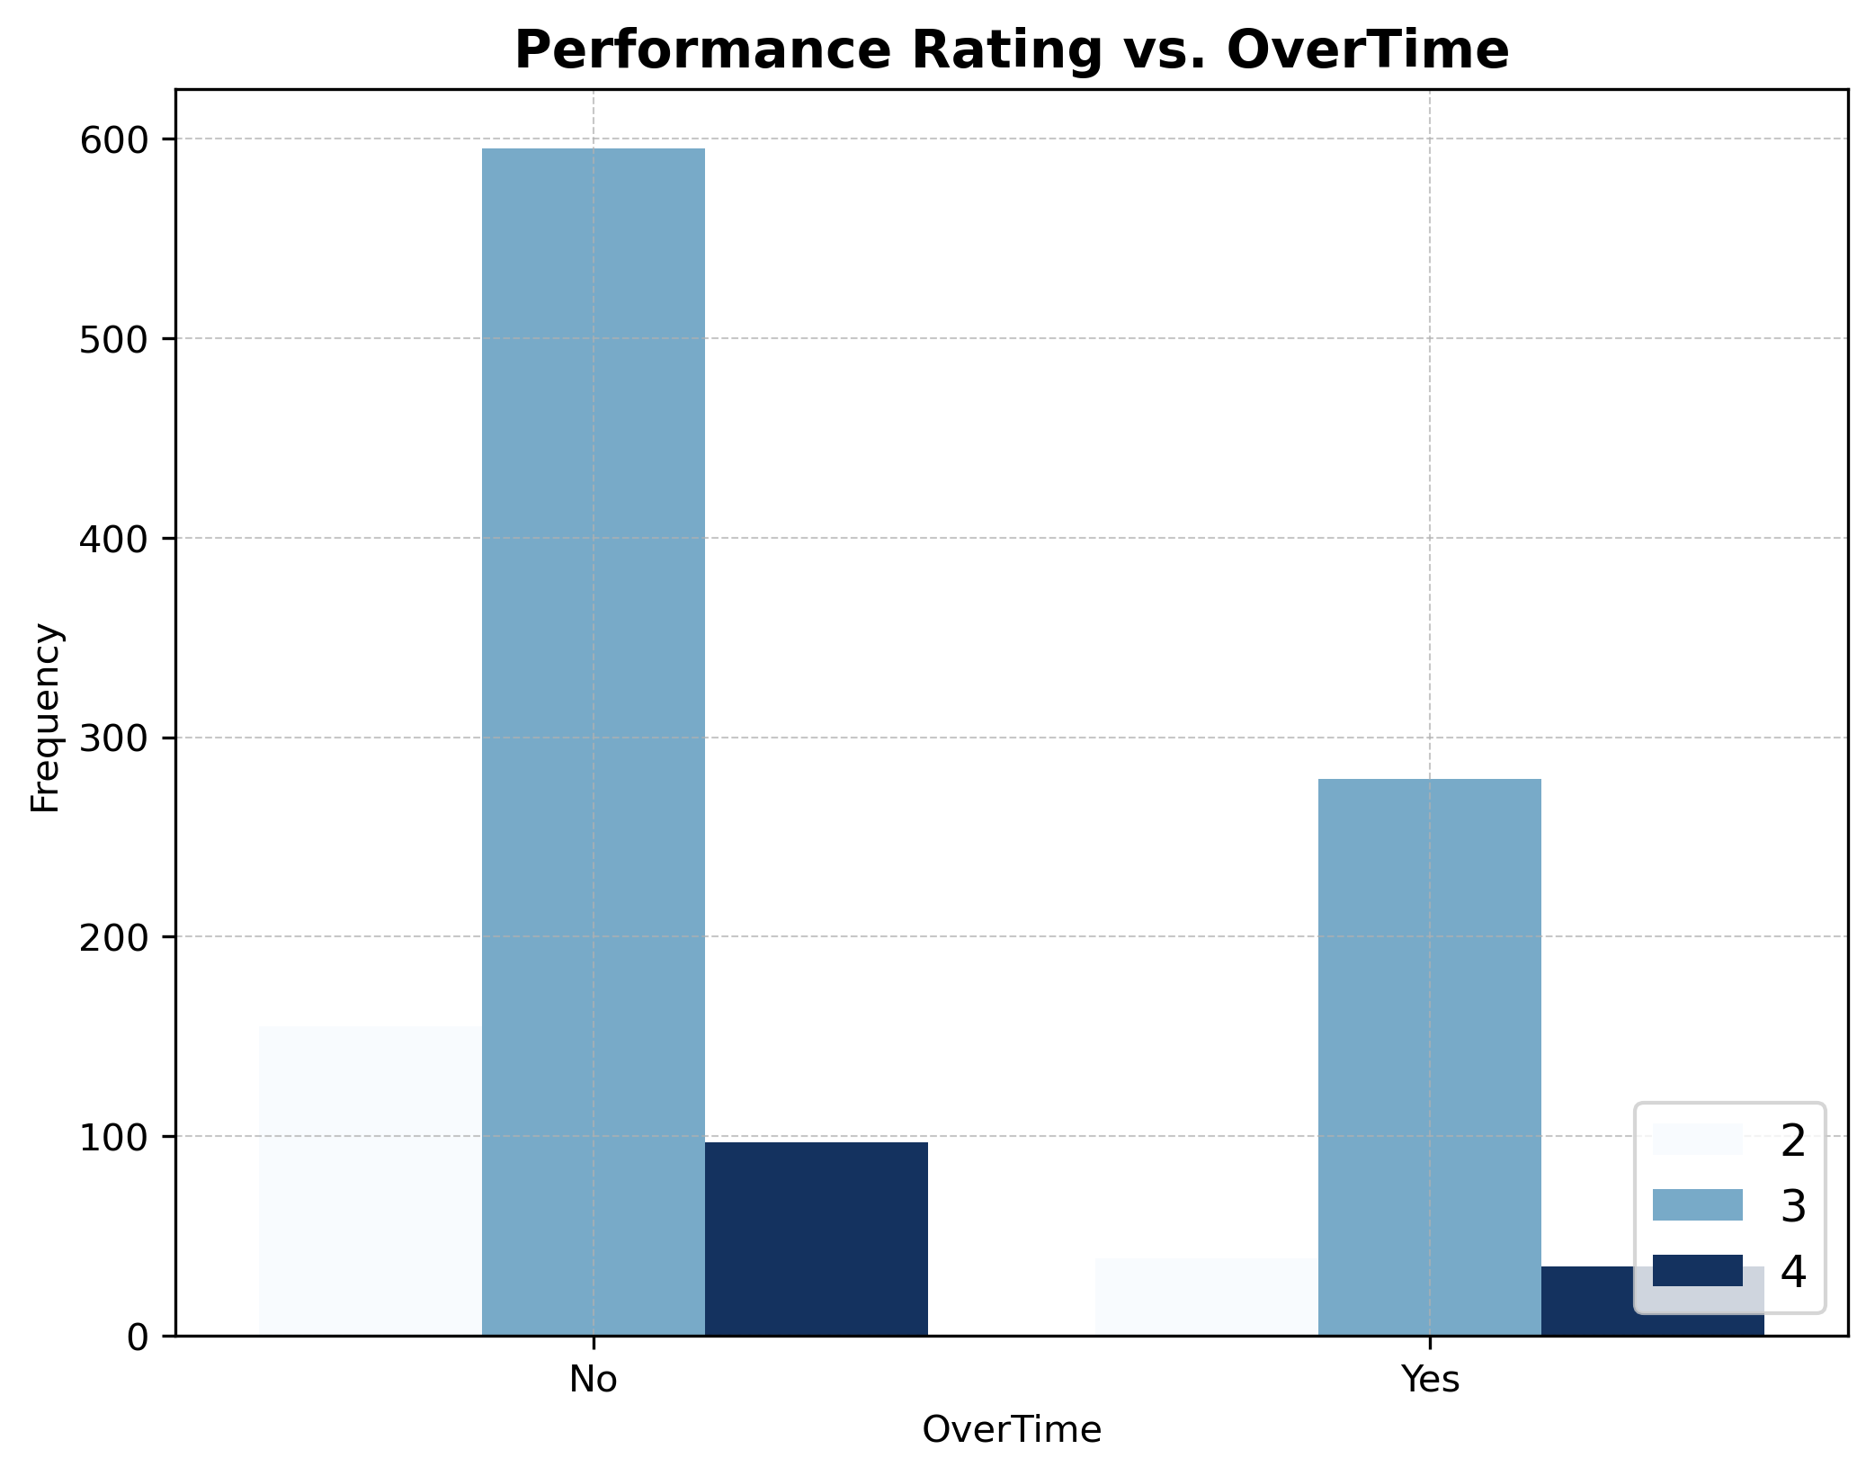
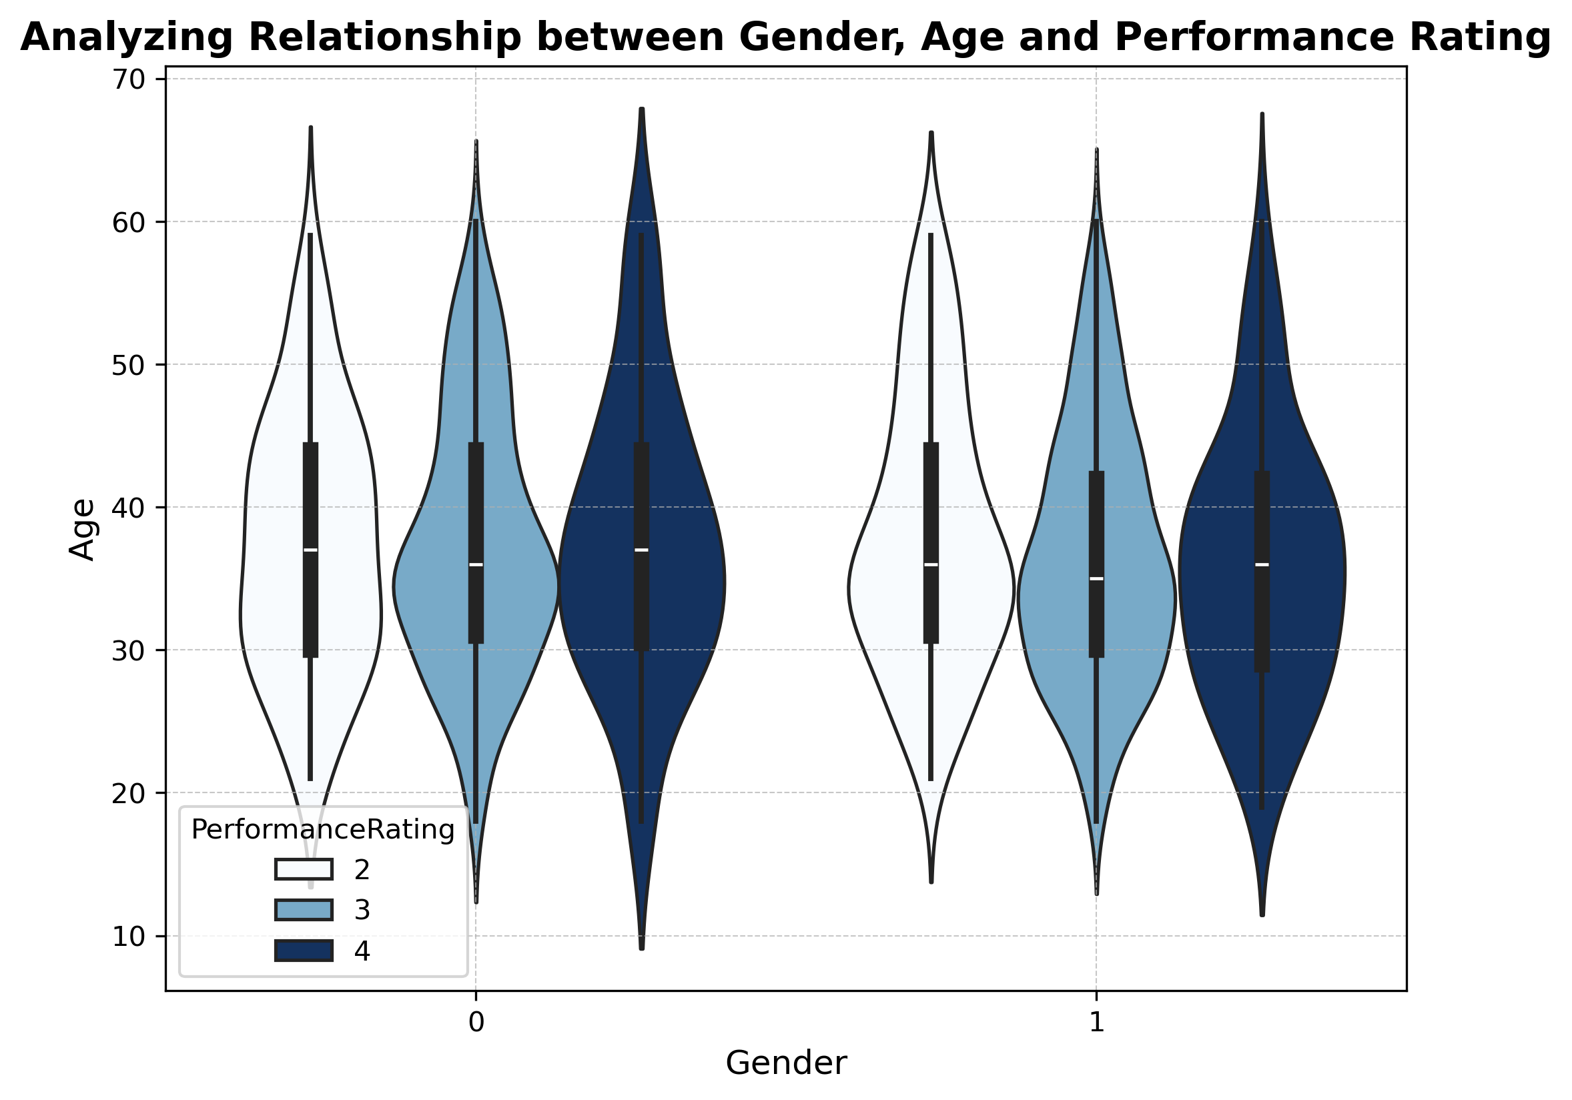
Multivariate Visualizations
About 600 employees who do not work overtime had a satisfactory performance rating(3), over 100 employees had a poor performance rating(2) while around 100 had an outstanding rating(4). Among those who work overtime, about 300 had a satisfactory rating(3), and fewer than 50 had an outstanding rating(4) and a poor performance rating(2).
A slightly higher proportion of male employees have a performance rating of 2 compared to female employees. However, other performance ratings are evenly distributed between genders, suggesting equal opportunities in performance evaluation. Additionally, the majority of employees are between 30 and 40 years old, indicating that the workforce primarily consists of mid-career professionals.

Slide 16
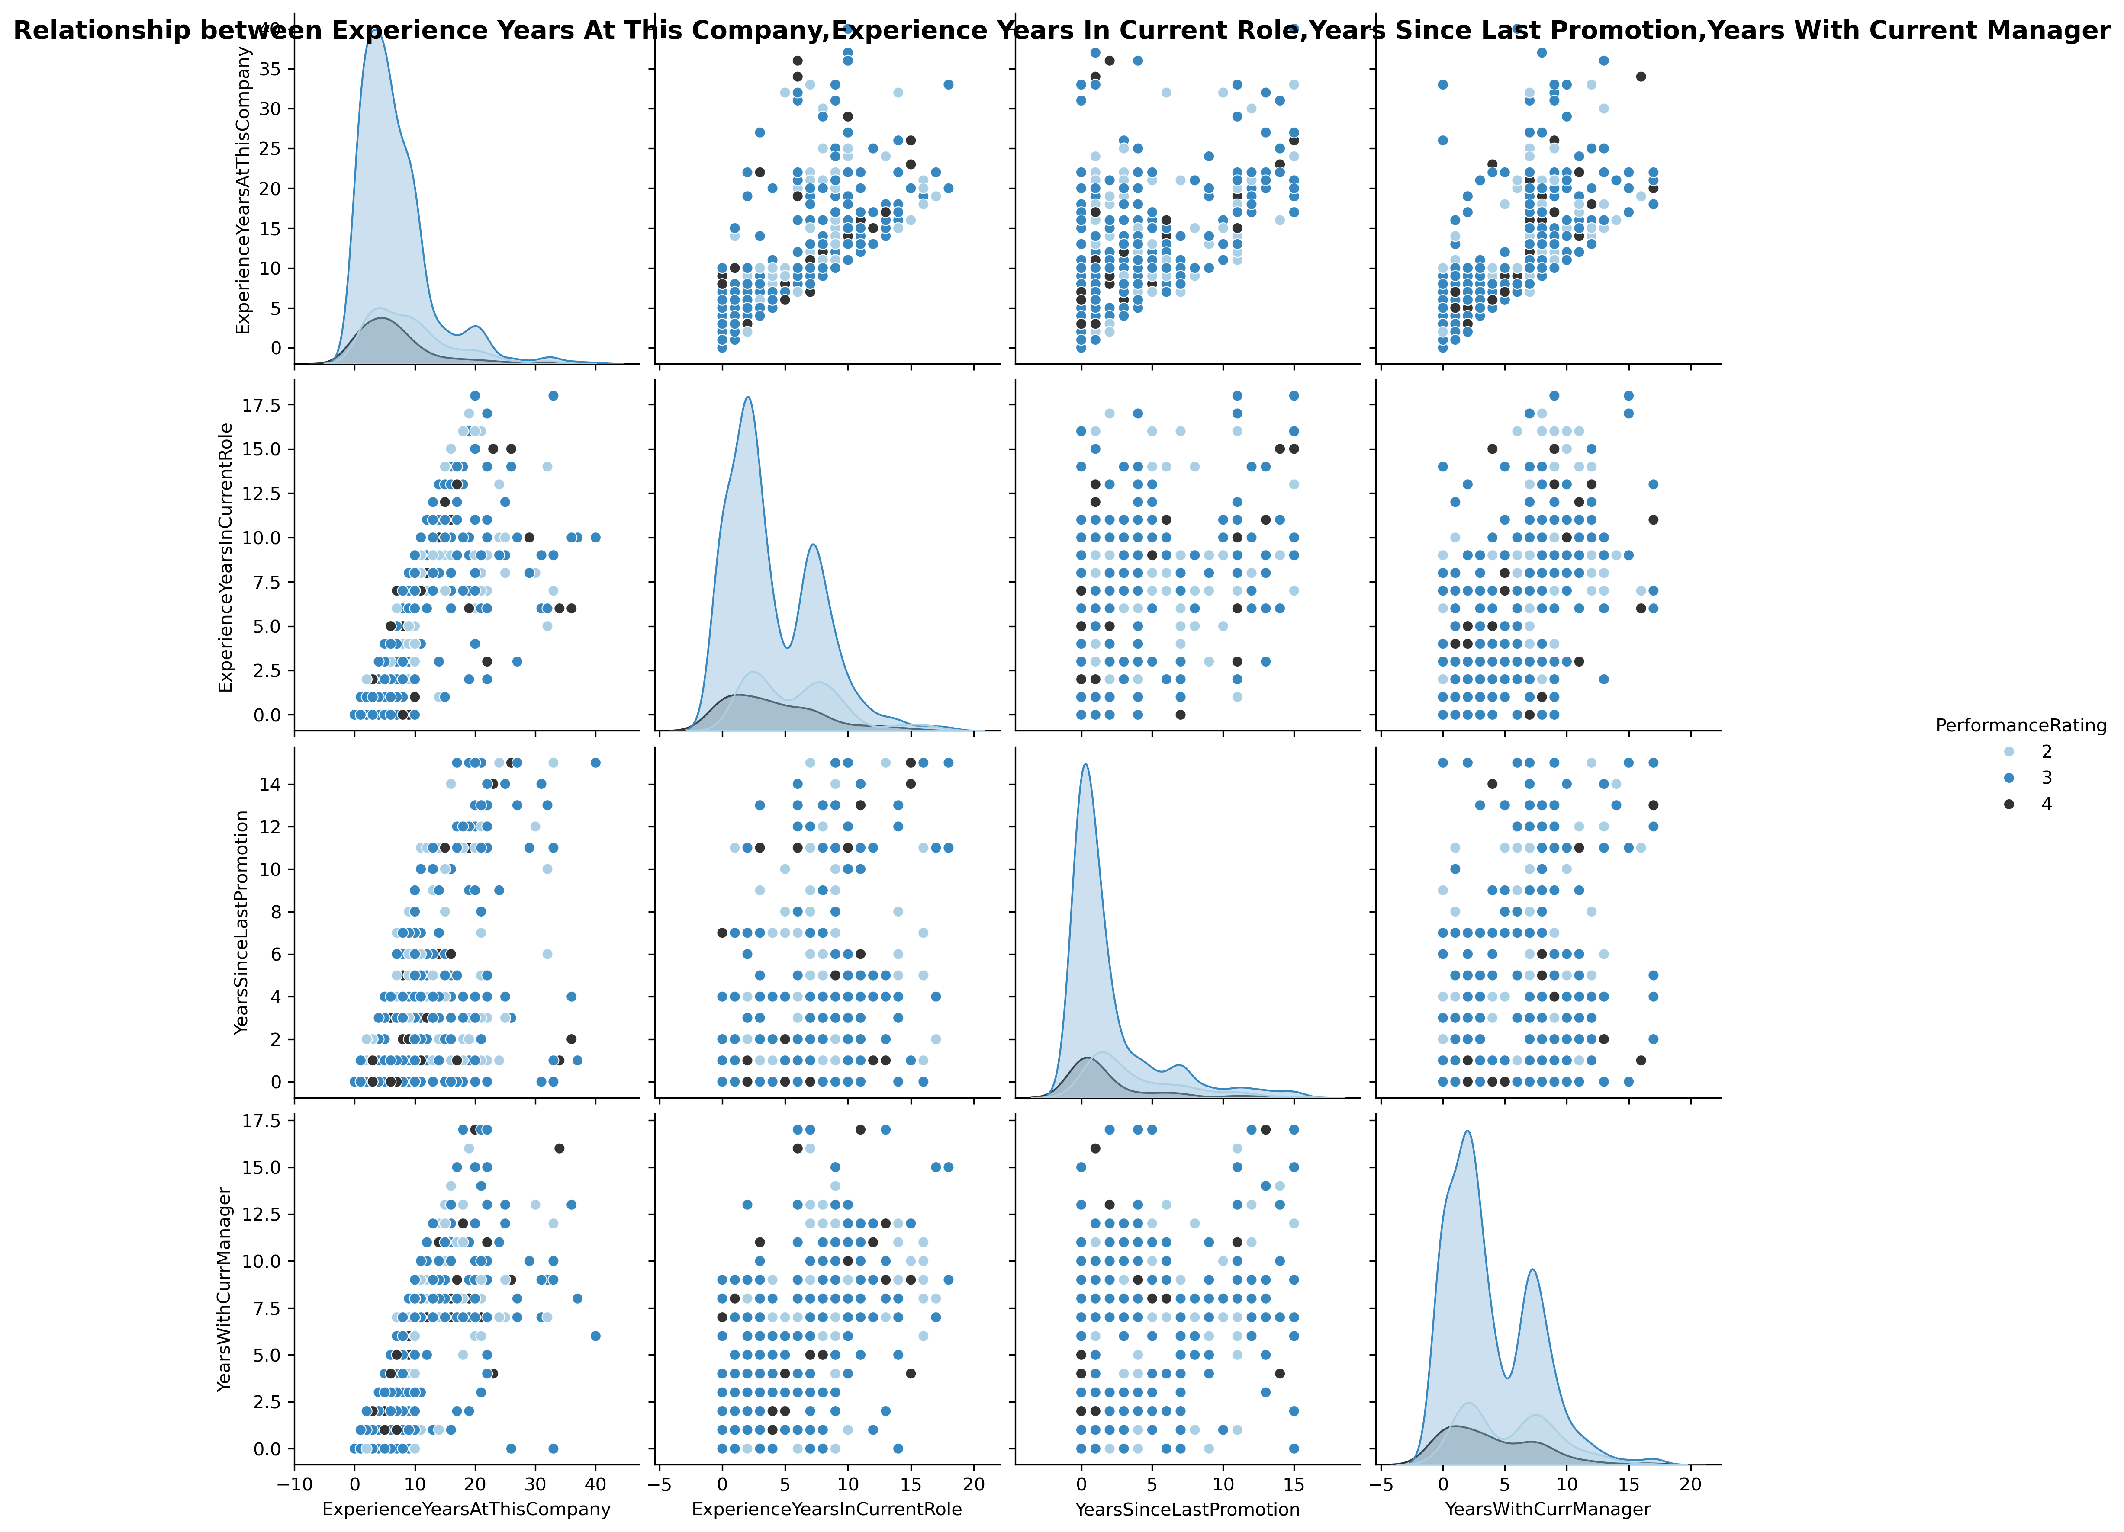
Multivariate Visualizations
Employees with longer experience at the company also tend to have spent more time in their current role indicating a strong positive correlation between experience years at Company and Experience years in current role. However some employees have changed roles multiple times.
Employees who have been with the company longer generally have more years since their last promotion indicating a moderate positive correlation between experience years at company and years since last promotion. Meaning that long tenure does not guarantee frequent promotions.

Slide 17
Continuation (Relationship between Experience Years At This Company, Experience Years In Current Role, Years Since Last Promotion, Years With Current Manager)
Employees who have worked in the same role for many years often remain with the same manager for large periods showing a strong positive correlation between years in current role and years with current manager. However some employees have changed managers multiple times.
Employees who have been with the company longer generally have more years since their last promotion indicating a moderate positive correlation between experience years at company and years since last promotion meaning that long tenure does not guarantee frequent promotions.
Employees with more experience years often remain with the same manager for large periods showing a strong positive correlation between experience years and years with current manager. However some employees have changed managers multiple times.
Employees who stay longer under the same manager tend to go longer without a promotion indicating a weak positive correlation between years since last promotion and years with current manager. This could indicate overlooked talent.
Performance ratings are evenly distributed in all diagrams as shown above meaning it doesn't have a huge impact on these variables.

Slide 18
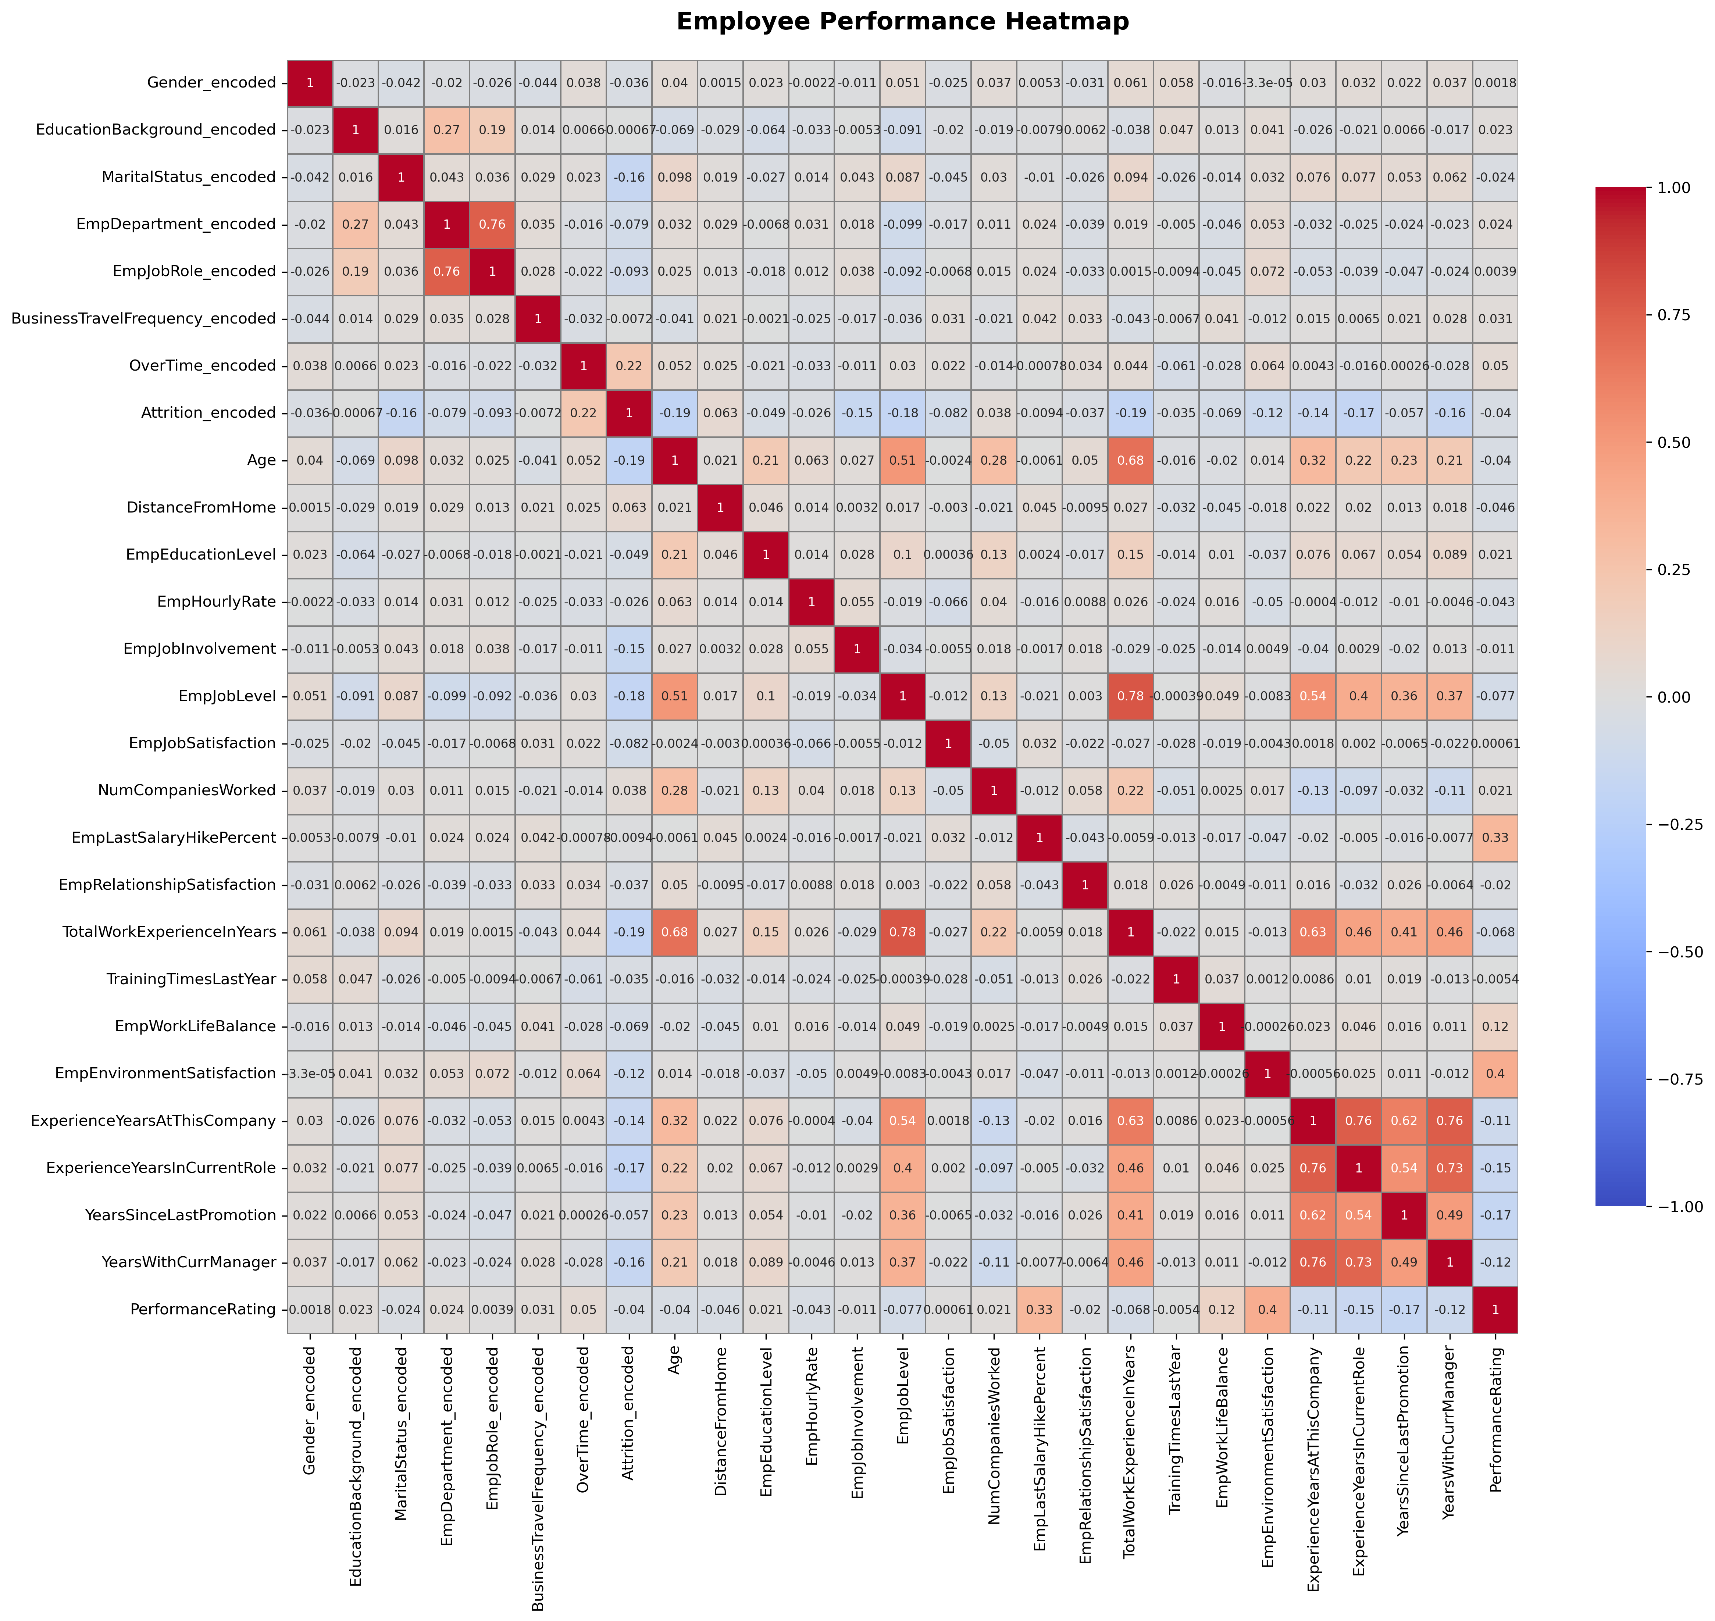
Employee Environment Satisfaction(0.4), Employee Last Salary Hike Percent (0.33) and Employee Work-Life Balance (0.12) have a weak positive correlation with Performance Rating, indicating a minor positive impact on performance rating.
Employee Department (-0.16) suggests that performance ratings may vary across departments, warranting further investigation. Experience Years at This Company (-0.11), Experience Years in Current Role (-0.15), Years Since Last Promotion (-0.17), and Years with Current Manager (-0.12) are weakly negatively correlated with Performance Rating, indicating that longer tenure in a role without progression may reduce motivation and performance ratings.
Gender, Education Background, Marital Status, Business Travel Frequency, Overtime, Attrition, Age, Distance from Home, Employee Education Level, Employee Hourly Rate, Employee Job Involvement, Employee Job Level, Employee Job Satisfaction, Number of Companies Worked, Employee Relationship, Total Work Experience in Years, and Training Times Last Year are weakly correlated with Performance Rating, as their correlation values are close to zero.
Overall, the variables are weakly correlated with performance rating, suggesting that other factors contribute more significantly to performance outcomes.

Slide 19
MODEL SELECTION
1. Identify the target variable and features:
Target- Performance Rating
Features- Employee Department , Employee Environment Satisfaction, Employee Last Salary Hike Percent , Employee Work Life Balance , Experience Years At This Company , Experience Years In Current Role, Years Since Last Promotion ,Years With Current Manager. The other features are weakly correlated with Performance Rating, as their correlation values are close to zero based on the heatmap and visualizations. Therefore, these features were excluded from the analysis.
2. Standardized X features using Standard Scaler.
3. Split the data into training and testing sets using the 80-20 ratio.
Models Used
1. Gradient Boosting Model
2. Logistic Regression Model
3. XGBoost Model

Slide 20
MODEL PERFORMANCE COMPARISON
1. Decision Tree Model
Accuracy:
87% of predictions are correct (either class 2,3, or 4). It shows that the model is a good fit.
Precision:
For class 2 (performance rating 2): 75% of the predictions made as 0 were correct.
For class 3 (performance rating 3): 92% of the predictions made as 1 were correct.
For class 4 (performance rating 4): 69% of the predictions made as 2 were correct.
Recall:
For class 2 (performance rating 2): 72% of actual 0 cases were correctly predicted.
For class 3 (performance rating 3): 91% of actual 1 cases were correctly predicted.
For class 4 (performance rating 4): 74% of actual 2 cases were correctly predicted.
F1-Score:
A harmonic mean of precision and recall, reflecting the balance between false positives and false negatives:
Class 2: 0.74 - Good overall performance for this class.
Class 3: 0.92 - Strong performance for this class.
Class 4: 0.71 - Good performance for this class.
Confusion Matrix:
Class 2 (performance rating 2): 21 were correctly classified, while 8 was misclassified as Class 3.
Class 3 (performance rating 3): 168 were correctly classified, with 7 misclassified as Class 2 and 9 as Class 3.
Class 4 (performance rating 4): 20 were correctly classified, but 7 was misclassified as Class 3.
Accuracy Score: 0.87
Classification Report: | precision | recall | f1-score | support
2 | 0.75 | 0.72 | 0.74 | 29
3 | 0.92 | 0.91 | 0.92 | 184
4 | 0.69 | 0.74 | 0.74 | 27
Confusion Matrix
[[ 21 8 0]
[ 7 168 9]
[ 0 3 20]]

Slide 21
2. Random Forest Model
Accuracy Score: 0.94
Classification Report: | precision | recall | f1-score | support
2 | 0.87 | 0.90 | 0.88 | 29
3 | 0.95 | 0.97 | 0.96 | 184
4 | 0.95 | 0.74 | 0.83 | 27
Confusion Matrix
[[ 26 3 0]
[ 4 179 1]
[ 0 7 20]]
Accuracy:
94% of predictions are correct (either class 2,3, or 4). It shows that the model is a good fit.
Precision:
For class 2 (performance rating 2): 87% of the predictions made as 0 were correct.
For class 3 (performance rating 3): 95% of the predictions made as 1 were correct.
For class 4 (performance rating 4): 95% of the predictions made as 2 were correct.
Recall:
For class 2 (performance rating 2): 90% of actual 0 cases were correctly predicted.
For class 3 (performance rating 3): 97% of actual 1 cases were correctly predicted.
For class 4 (performance rating 4): 74% of actual 2 cases were correctly predicted.
F1-Score:
A harmonic mean of precision and recall, reflecting the balance between false positives and false negatives:
Class 2: 0.88 - Good overall performance for this class.
Class 3: 0.96 - Strong performance for this class.
Class 4: 0.83 - Good performance for this class.
Confusion Matrix:
Class 2 (performance rating 2): 26 were correctly classified, while 3 was misclassified as Class 3.
Class 3 (performance rating 3): 179 were correctly classified, with 4 misclassified as Class 2 and 1 as Class 3.
Class 4 (performance rating 4): 20 were correctly classified, but 7 was misclassified as Class 3.

Slide 22
3. Gradient Boosting Model
Accuracy:
93% of predictions are correct (either class 2,3, or 4). It shows that the model is a good fit.
Precision:
For class 2 (performance rating 2): 86% of the predictions made as 0 were correct.
For class 3 (performance rating 3): 94% of the predictions made as 1 were correct.
For class 4 (performance rating 4): 91% of the predictions made as 2 were correct.
Recall:
For class 2 (performance rating 2): 83% of actual 0 cases were correctly predicted.
For class 3 (performance rating 3): 97% of actual 1 cases were correctly predicted.
For class 4 (performance rating 4): 74% of actual 2 cases were correctly predicted.
F1-Score:
A harmonic mean of precision and recall, reflecting the balance between false positives and false negatives:
Class 2: 0.84 - Good overall performance for this class.
Class 3: 0.95 - Strong performance for this class.
Class 4: 0.82 - Good performance for this class.
Confusion Matrix:
Class 2 (performance rating 2): 24 were correctly classified, while 5 was misclassified as Class 3.
Class 3 (performance rating 3): 178 were correctly classified, with 4 misclassified as Class 2 and 2 as Class 3.
Class 4 (performance rating 4): 20 were correctly classified, but 7 was misclassified as Class 3.
Selection deleted
Accuracy Score: 0.93
Classification Report: | precision | recall | f1-score | support
2 | 0.86 | 0.83 | 0.84 | 29
3 | 0.94 | 0.97 | 0.95 | 184
4 | 0.91 | 0.74 | 0.82 | 27
Confusion Matrix
[[ 24 5 0]
[ 4 178 2]
[ 0 7 20]]

Slide 23
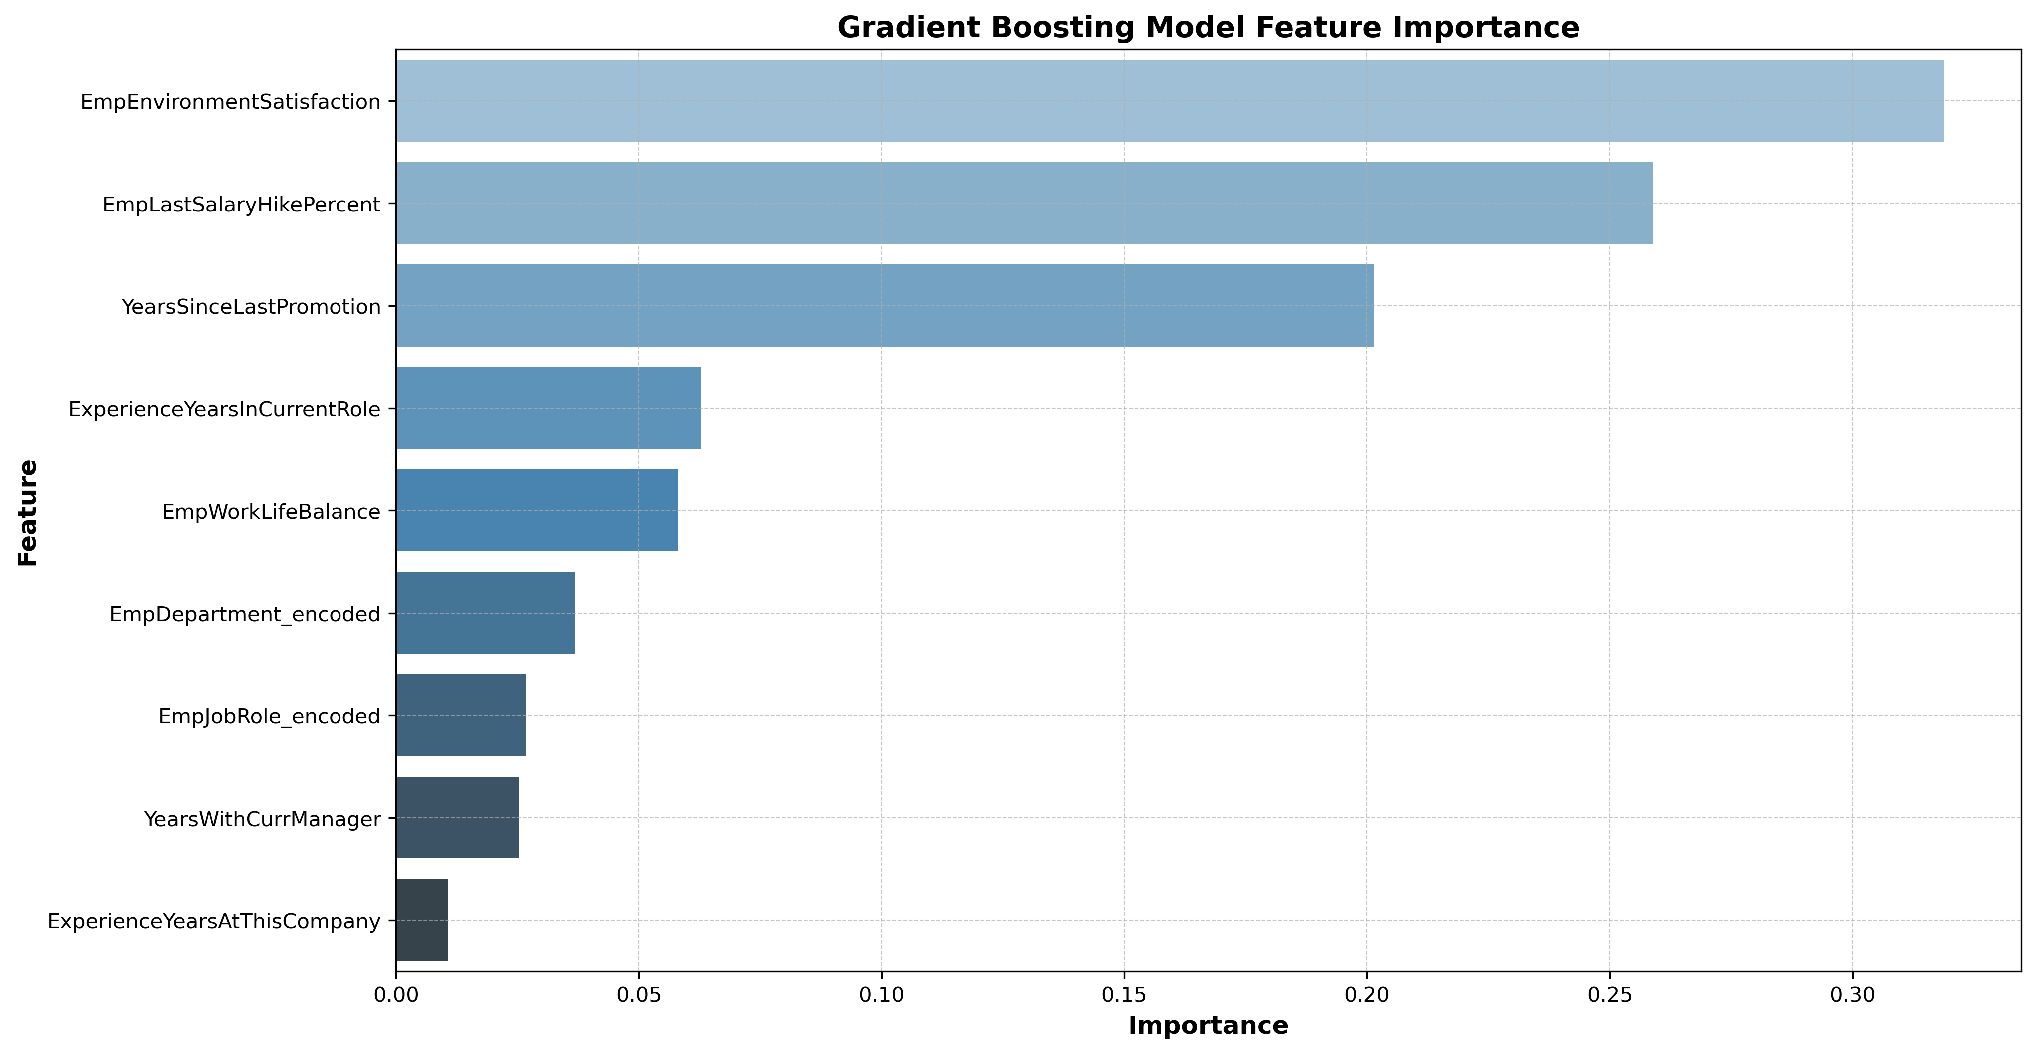
Final Model and Insights
Final Model
Random Forest Model. This is because of its high accuracy and performance since it has high F1 scores compared to the other models.
Key Insights:
Employee Work Environment is the most influential in predicting Performance Ratings followed by Last Salary Hike and Years Since Last Promotion as shown in the feature importance bar plot. They are the best 3 features.
Addressing disparities across departments, ensuring fair compensation adjustments, and work promotions initiatives can enhance overall workforce efficiency and satisfaction.

Slide 24

Recommendations
Improve Workplace Satisfaction- Since environment satisfaction is the most influential factor, organizations should invest in employee well-being by fostering a positive work culture, offering flexible work arrangements, and ensuring job security.
Better Pay & Work-Life Balance – Offering fair salary increases, flexible work schedules, and wellness programs can help employees feel valued and motivated.
Opportunities for Growth – Providing regular promotions, skill-building workshops, and chances to move within the company can keep employees engaged and productive.
Helping Struggling Departments – Identifying teams that need extra support and addressing leadership, workload, and engagement challenges will create a more balanced work environment.
Fairer Performance Reviews – Using peer feedback, clear goals, and skill-based assessments can make evaluations more transparent and effective.
Smarter Hiring & Development – Leveraging a predictive model can help the company identify top talent and provide targeted development for employees.
Conclusion
Work Environment, Fair pay, and career growth play a big role in employee performance. Tackling stagnation and department-specific challenges can boost productivity while keeping INX’s reputation as a great place to work.
RECOMMENDATIONS AND CONCLUSION

Slide 25
Stream lit App Deployment
Interactive Web Application
This website is designed to help INX understand key factors affecting employee performance. By analyzing various workplace and personal factors, it provides valuable insights to improve productivity, engagement, and retention while hiring new employees.
Features: The employer is required to input data on the following features in order to predict the employees performance rating ; Employee Department , Employee Environment Satisfaction ,Employee Last Salary Hike Percent , Employee Work Life Balance , Experience Years At This Company , Experience Years In Current Role, Years Since Last Promotion ,Years With Current Manager.
Here is the stream lit link to the website: https://employee-performance-test-ubdzemujmdf75zxzs3bwn5rnx.streamlit.app/

